Slide 1
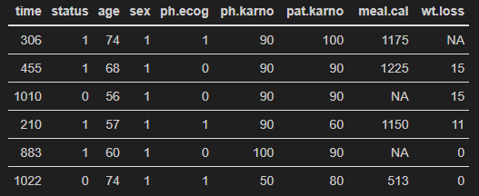
Censor
Death

Slide 2
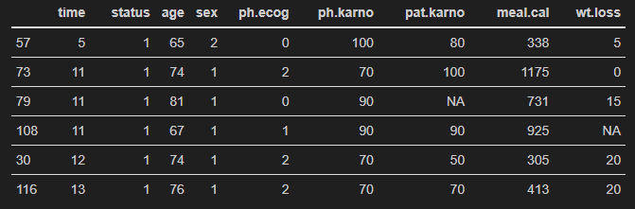
No. subjects at risk
(Inst. Hazard) Cumulative Hazard
228
227
227
227
224
223
(1/228 = 0,004) 0,00400
(1/227 = 0,0044) xxxxxx
(1/227 = 0,0044) xxxxxx
(1/227 = 0,0044) 0,0172
(1/224 = 0,0045) 0,0217
(1/223 = 0,0045) 000000
<

